Slide 1

Getting started with MonoGame using Visual Studio 2019
Darkside of Monogame
Simon Jackson
Author and Microsoft MVP
@SimonDarksidej

Slide 2

Headline Information
MonoGame 3.8 is about to release
.NETCore and .NetStandard support
New .NetCore tools delivery
No MSI!!
Visual Studio 2019 is the latest edition of Visual Studio

Slide 3
Getting Started – Visual Studio 2019
Session will cover what is needed for:
Developing games for Windows desktop / Linux / OpenGL
Building Content Pipeline Projects
Developing Games for Android
Developing Games for iOS / MacOS
Developing Games for Windows 10 UWP

Slide 4
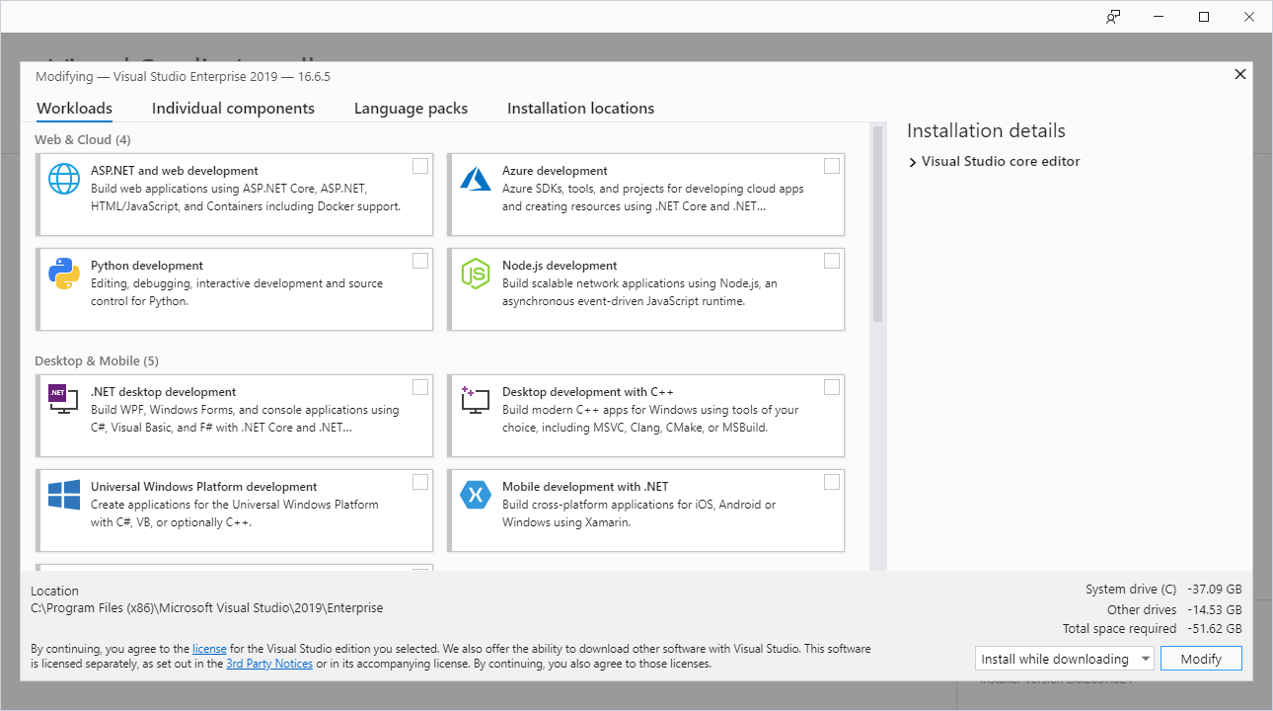
The new Visual Studio 2019 installer

Slide 5

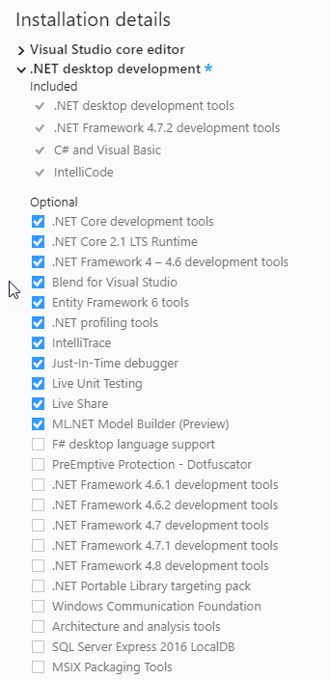
Visual Studio 2019 .NET install
Out of the box with VS 2019 (not selecting anything) you cannot do much (Except create a blank VS solution :S)
By installing the .NET desktop module, you can build the following project types:
Windows Desktop DX (classic)
Cross-Platform OpenGL (Linux / Windows / Etc.)
Content Pipeline Extensions
Gets you a basic game up and running or several platforms
Be sure to check the video below for best-practices in setting up a multi-platform MonoGame Project:
http://bit.ly/monogamemulti-platform

Slide 6
New for MonoGame 3.8 - .NET Core support
MonoGame 3.8 changes the way MonoGame is deployed.
New NuGet by default supported projects, no installer needed.
Templates are now deployed by Visual Studio Extension.
Command-Line Interface (CLI) options available.
MonoGame just got way cooler.

Slide 7
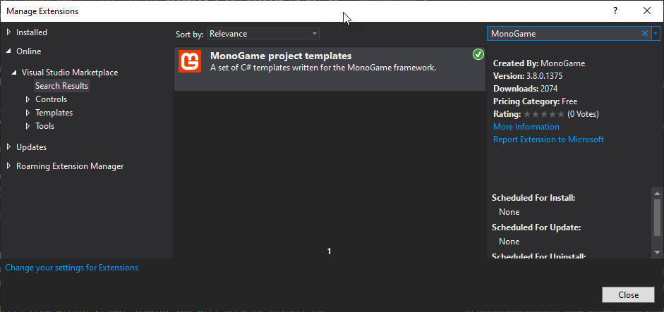
MonoGame project templates
Extensions installed from within Visual Studio
Open a new project (any) and select “Extensions -> Extension Manager” From the menu
Search for “MonoGame” in the Visual Studio Marketplace
*Check the online documentation for installing “Development” builds https://docs.monogame.net/articles/getting_started/getting_started.html

Slide 8


MonoGame Content Builder Editor (MGCB)
Provided you have installed the .NETCore SDK https://dotnet.microsoft.com/download
Installing the MCGB-Editor is just two simple Command-Line Commands
One to Install the tool and one to register it with Visual Studio and Windows

Slide 9
Building for Android
What is required for android development

Slide 10


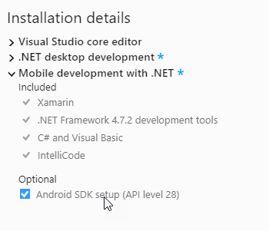
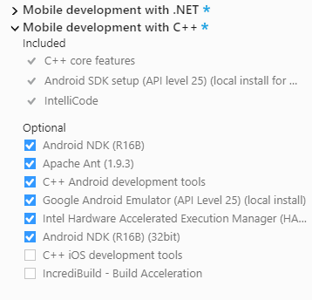
Android setup for Visual Studio 2019
Requires the Mobile development with .NET module
Requires Android SDK/NDK for target builds (Can add additional SDK/NDK versions after install)
For additional SDK’s and the Visual Studio Android Emulator, also install the “Mobile Development with C++” module
Optional – Google Android emulator

Slide 11

Tips ‘n’ tricks with Android
Be aware it’s a fragmented platform – likely need several projects
Ideally use a device to test and deploy to, or use Google Emulator if you are desperate 🤷‍♂️
Physically testing is critical due to device differences, plan ahead and use Visual App Center to build / test and deploy your game to multiple devices. https://appcenter.ms/

Slide 12
Building for iOS / MacOS
What is required for Apple development

Slide 13
iOS setup for Visual Studio 2019
Only requires the Mobile development with .NET module
Requires a MAC build host machine!

Slide 14

Tips ‘n’ tricks with iOS / MacOS
iOS builds require a MAC to build on, can develop on Windows
Cannot build for MAC on Windows. Can only be done on a MAC 🐱‍👓
Physically testing is critical due to device differences, plan ahead and use Visual App Center to build / test and deploy your game to multiple devices https://appcenter.ms/

Slide 15
Sorting out your Mac Build Host
You need a MAC ☺ but can be done with a cheap Mac Mini if you don’t have one (But check the following requirements before buying)
Requires:
The latest iOS SDK.
The latest version of XCode.
Mac OS X Yosemite(10.10) & above.
Apple Dev Center account
Visual Studio for Mac is FREE
Extended capabilities will require an MSDN subscription
See the following site for more details https://docs.microsoft.com/en-us/visualstudio/mac/installation

Slide 16
Building for Windows 10 UWP
What’s required for Windows 10 development
Windows / Mobile / Xbox / IOT / HoloLens

Slide 17

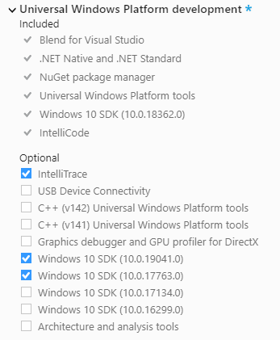
Windows 10 Visual Studio 2019 profile
Requires Universal Windows App Development Tools
Required SDK versions will depend on your target audience, usually the latest 2 versions is sufficient.
Windows 10 machine enabled for either “Sideloading” apps or “Development Mode” Settings -> Update & Security -> For Developers
Windows Store license required to ship (one time fee)

Slide 18
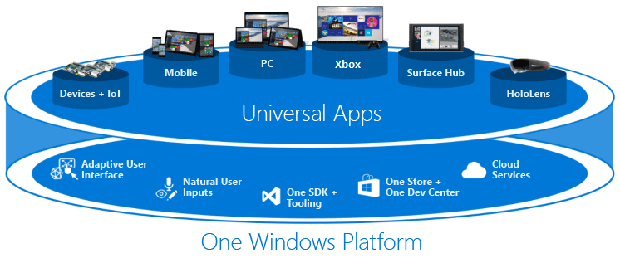
Tips ‘n’ tricks with Windows 10
“It just works” ™ :D
As UWP is a “one size fits all” platform, plan for resolution / input patterns that your game will use. Remembering some platforms don’t have touch (I’m looking at you Xbox!)
MonoGame fully supports the new “Creators Dev program” as well as ID@XBox
If you want to take your UWP game to native Xbox, talk to the MonoGame team for access to the Xbox branch (requires ID@XBox agreement)

Slide 19
Other considerations

Slide 20
Other considerations building with MonoGame
Plan your content If targeting multiple platforms, try to use a single shared content project to reduce overhead Add additional “platform specific” content projects only when required
Market early It’s essential to build up good relations with each market store. Almost never too early to “get out in front”
Test often Some platforms will require more testing than others, plan to test deployment and not just gameplay. Use test tools where possible.

Slide 21
Thanks for watching
Darkside of Monogame
Simon Jackson
Author and Microsoft MVP
@SimonDarksidej

